Slide 1
Digital Watermarking: Embedding and Extraction in Signal Processing
By: Jaiden Gann

Slide 2
Outline
Introduction to Watermarking
Project Goal
Watermarking Algorithms:
Spatial Domain
Transfer Domain
Robust
Implementation Plan
Notes:
I will briefly go over what watermarking is and the Project’s Goal.
Then I will give talk about some of the different Watermarking Algorithms which are divided into three categories: Spatial Domain, Transfer Domain, and Robust
Then go over my plan for implementing a watermarking system using matlab

Slide 3
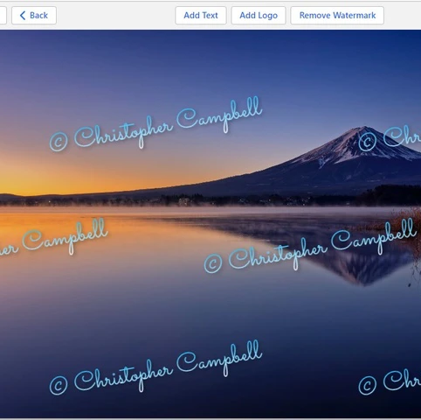
Introduction to Watermarking
Watermarking is used to protect the copyright and integrity of multimedia content
Main objective of watermarking:
Robustness against various attacks
Ensure invisibility
Two main steps:
Embedding
Extraction
Notes:
Read first bullet. The watermark is imperceptible data that is embedded in media and can carry information about the copyright owner, authentication, or other relevant meta data.
Main objective of watermarking is ensuring the invisibility of the embedded watermark and maintaining its robustness against attacks such as compression, filtering, or noise addition.
Theres usually two steps: embedding and extraction. Embedding is when the watermark is inserted into the host media using a predetermined algorithm. Extraction is retrieving the watermark to allow verification or retrieval of the embedded information

Slide 4
Project Goal
Main Goal:
Design and implement a reliable digital watermarking system using Matlab
Watermarking algorithms:
LSB, DCT, DFT, DWT, SVD
Secondary Goal: Remove watermarks from:
Images that the system added the watermark to
Images from other sources that already have watermarks

Slide 5
Watermarking with Matlab
Matlab will allow for functions to be easily created for the watermarking techniques
Allows visualization of the media:
Histogram plots
Display changed images
Collection of built-in images

Slide 6
Watermarking Algorithms: Spatial Domain
Least Significant Bit (LSB) Substitution:
Replaces least significant bits of the pixel values
Spread Spectrum:
Spreads watermark across image
Extracted using correlation-based technique and secret key
Difference Expansion:
Modifies differences between pixel values
Exploits human visual system’s tolerance to small changes in pixel differences
Notes:
Spatial domain techniques directly modify pixel values and host media. Tend to be simpler to implement but more open to attacks
LSB: simplest and widely used, More vulnerable to attacks(lossy compression, noise addition, or filtering). Applied to different color channels or grayscale
Spread: Spreads watermark across the host image by adding low energy noise like signal derived from the watermark to the pixel values. One technique is the additive white Gaussian noise (pseudorandom sequences)
correlating image with reference signal. Robust against attacks including compression and noise
Difference: Differences between pixel values are modified by a specific factor to accommodate the watermark data. Vulnerable to some attacks, such as image compression or geometric transformations

Slide 7
Watermarking Algorithms: Transfer Domain
Discrete Cosine Transform (DCT):
Transform into frequency domain using DCT
Embedded by modifying DCT coefficients
Discrete Wavelet Transform (DWT):
Exploit multiresolution property of wavelet transforms
Embedded by modifying wavelet coefficients in different frequency bands or scales
Singular Value Decomposition (SVD):
Decompose image matrix into its singular values and vectors
Embedded by modifying the singular values or vectors to accommodate the watermark
Notes:
Transfer domain methods exploit frequency or spatial frequency characteristics of the media. May require more complex computations and be sensitive to certain attacks such as cropping or geometric transformations
DCT: Host image divided into blocks and DCT applied to each.
Typically done in the low frequency range.
provides good perceptual invisibility. Extracted using inverse DCT
DWT: image decomposed into different frequency subbands.
Typically performed in the high frequency subbands and more robust to attacks and less perceptually significant
Extracted applying inverse DWT
SVD: provide robustness against geometric transformations and compression as the singular values carry the essential image information. Extraction performed by computing the SVD and extracting the modified singular values or vectors

Slide 8
Watermarking Algorithms: Robust Domain
Robust Hash-Based:
Generates hash value from image
Embeds using the hash value
Fingerprinting
Embed unique identification code into image to identify rightful owner
Notes:
Aim to ensure robustness and integrity of watermark. Used mainly when protection of copyright and content authenticity is crucial
Hash: hash value serves as unique identifier. Embedded in way that preserves the computed hash value
extraction: hash value recomputed and if it matches the original hash value its considered valid
High security as any modification to the image will change the hash value
Fingerprinting:
Imperceptibly embedded by modifying the specific features or components of the image
Extraction: fingerprint can be extracted and compared to the owners database to identify unauthorized copies
Also in this category is a version of Spread Spectrum with Encryption

Slide 9
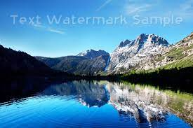
Implementation Plan
Use MatLab built-in demo images
Implement 2 – 3 Watermarking Algorithms
Compare the Algorithms
Display side by sides of original and watermarked images
Topics covered in class:
Image Processing
Signals Processing
Filtering
Notes:
At least one from the Spatial and one from the transfer domain
Matlab provides some techniques to analyzing the quality of watermarked media. (peak signal to noise ration, structural similarity index, bit error rate)
At this time I don’t have anything presentable for demo. Does anyone have any questions

